Slide 1
Tech Drop In: Google Drive

Slide 2
Objectives
Connect work email to Google
Know how to navigate to www.drive.google.com
Understand how to view your Drive
Practice how to upload different file types
Practice how to organize files/folders
Practice how to search for files/folders
Practice downloading files
Practice sharing files/folders

Slide 3
Open Google Chrome
Chrome works best when you are using Google products
If you do not have Google Chrome on your computer, go to this link to download it for free

Slide 4
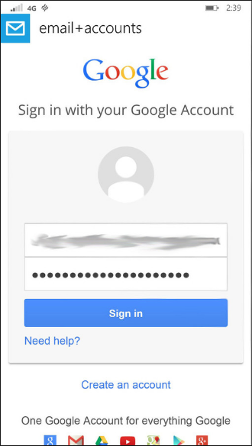
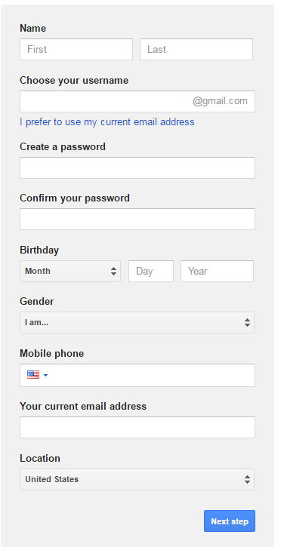
Connect work email to Google
Fill in your information and be sure to select “I prefer to use my current email address” and then type in your work email
You may be prompted to verify your account either through email or through a text message
Do NOT sign in with your personal account (if you have one)
Select Create an account

Slide 5
www.drive.google.com
Once you have connected your work email to Google, log in to your Google Drive
You have access to the full Google suite by clicking on the grid in the top, right corner

Slide 6
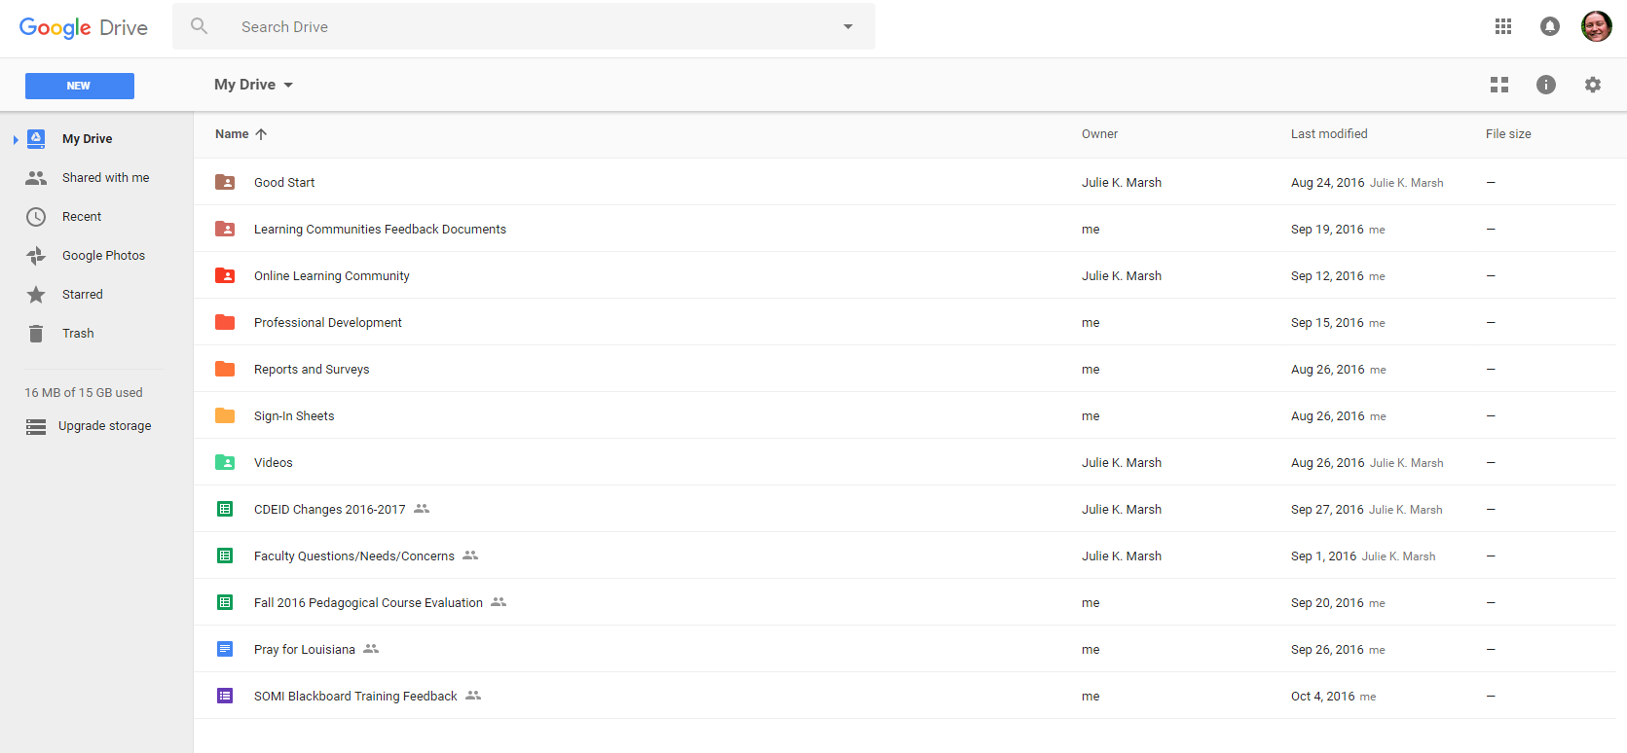
Understand how to view your drive
List View
Icon View

Slide 7
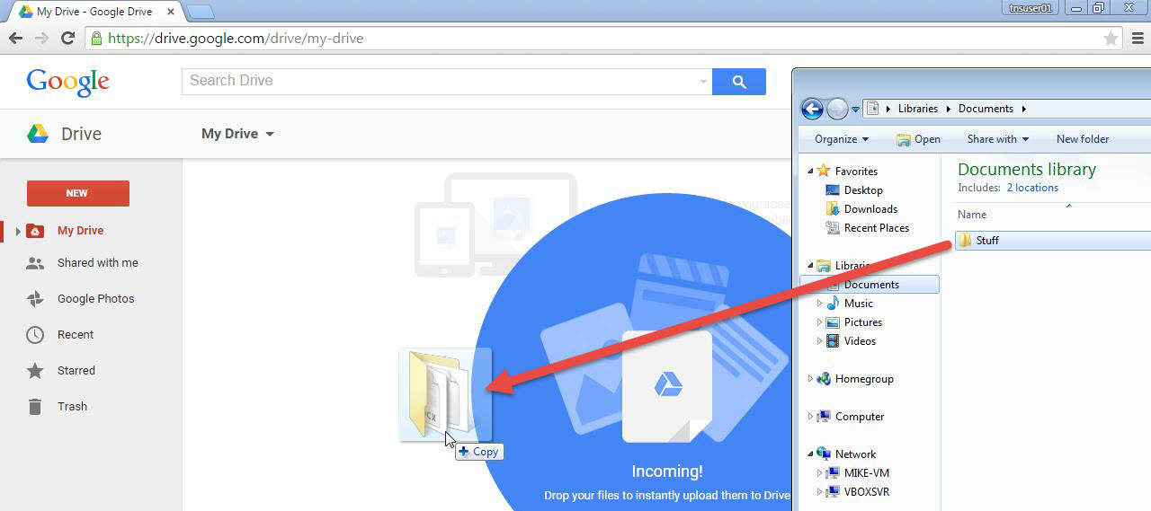
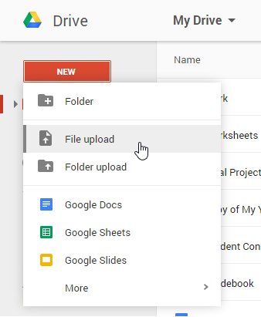
Practice how to upload different file types
You can upload documents, images, audio, and video into your Drive
You can upload any files into your Drive by dragging them from one folder onto your Drive screen (as seen above)
Or you can upload files by clicking on New (as seen to the left) and selecting File or Folder Upload; this will prompt you to find your file(s) saved on your computer

Slide 8
Practice how to upload different file types (cont.)
Practice:
Upload a document from your computer
Upload an image from your computer
Upload a video from your computer
Upload an audio file from your computer

Slide 9
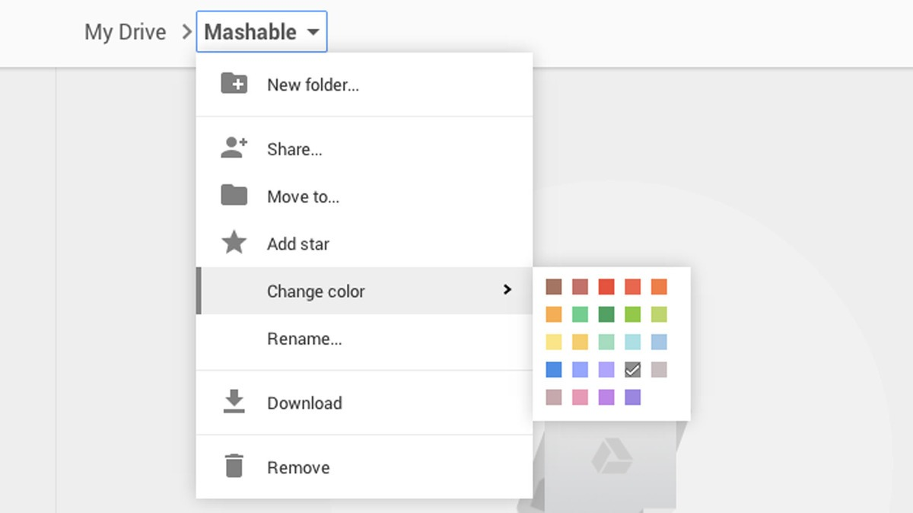
Practice how to organize files/folders
You can rename a file by right clicking on it and selecting Rename
You can color code your folders by right clicking, select Change color, and choose your color
You can create a new folder by right clicking and selecting New folder
You can move files and folders to other created folders by right clicking on them, choosing Move to, and selecting where you want it to go

Slide 10
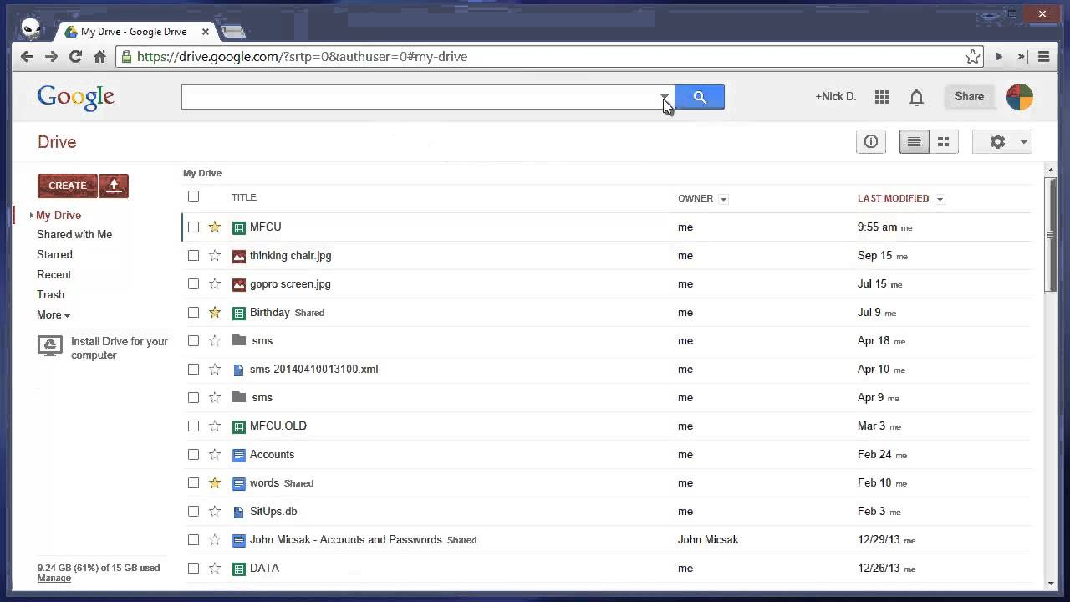
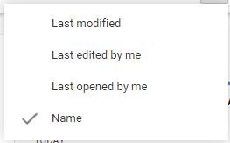
Search and sort files/folders
You can search for any files/folders by typing in the search bar at the top of your Drive
You can sort your files/folders by clicking on Last Modified and choosing how you want them sorted

Slide 11
Download files
You can download any of your files (or those shared with you) to your computer by right clicking and choosing Download
Note: some formatting may be a little off when going between Googledocs and Word docs or Google Slides and PowerPoint, so be sure to make sure your download is how you want it to look

Slide 12
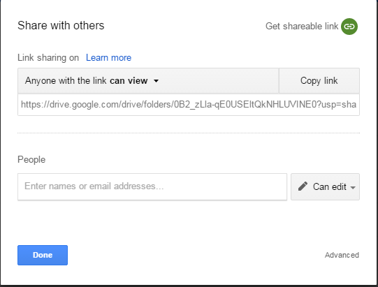
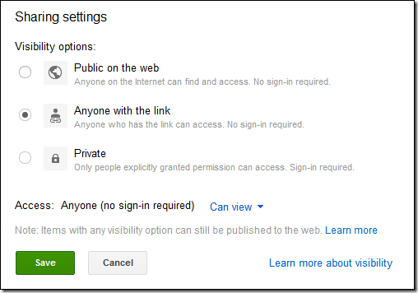
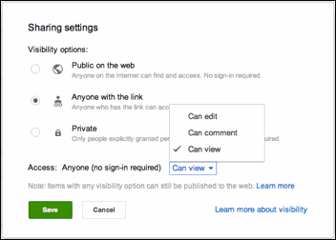
Share with others
3
4
1
2
You can share the URL
You can email specific people and give them different permissions (owner, editor, etc.)
You can change the URL share settings by clicking “can view” and then “more”
After clicking “more,” you can change visibility options and access options

Slide 13
resources
Google Drive Help
100 Important Drive Tips
Extras
Organize Drive Like a Pro
Even More!

